Slide 1
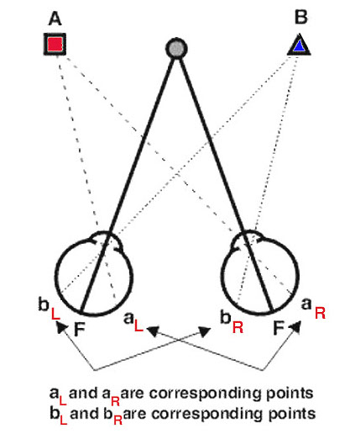
Recap
Source: Space Perception, Michael Kalloniatis and Charles Luu

Slide 2

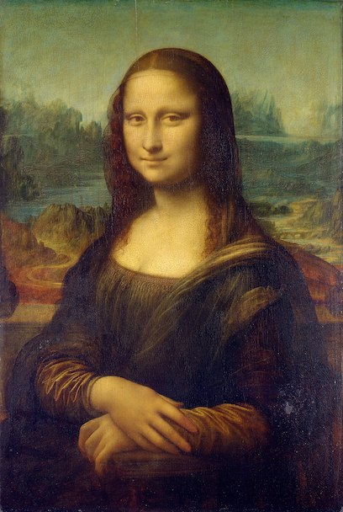
3D Visual Cues
Find 4 different depth/shape cues
Willem van de Velde the Elder's The Capture of the Royal Prince during the Four Days' Battle (1666)

Slide 3
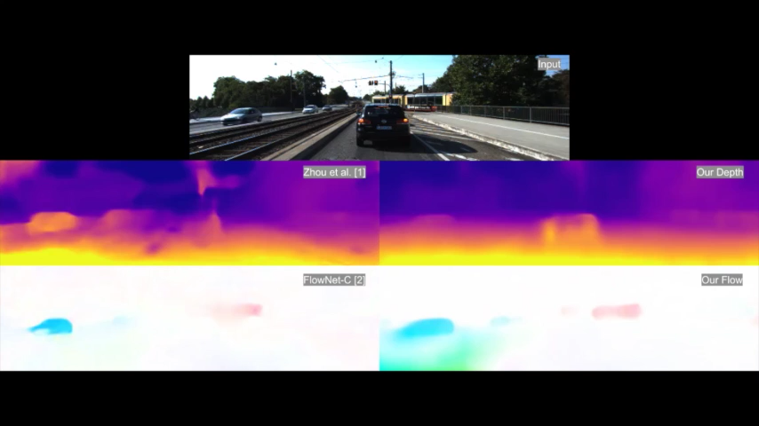
DF-Net: Unsupervised Joint Learning of Depth and Flow using Cross-Task Consistency
Yuliang Zou, Zelun Luo, Jia-Bin Huang

Slide 4

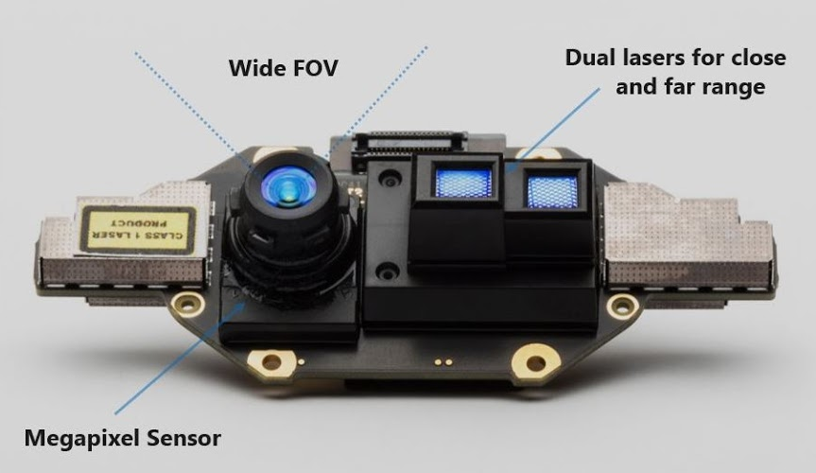
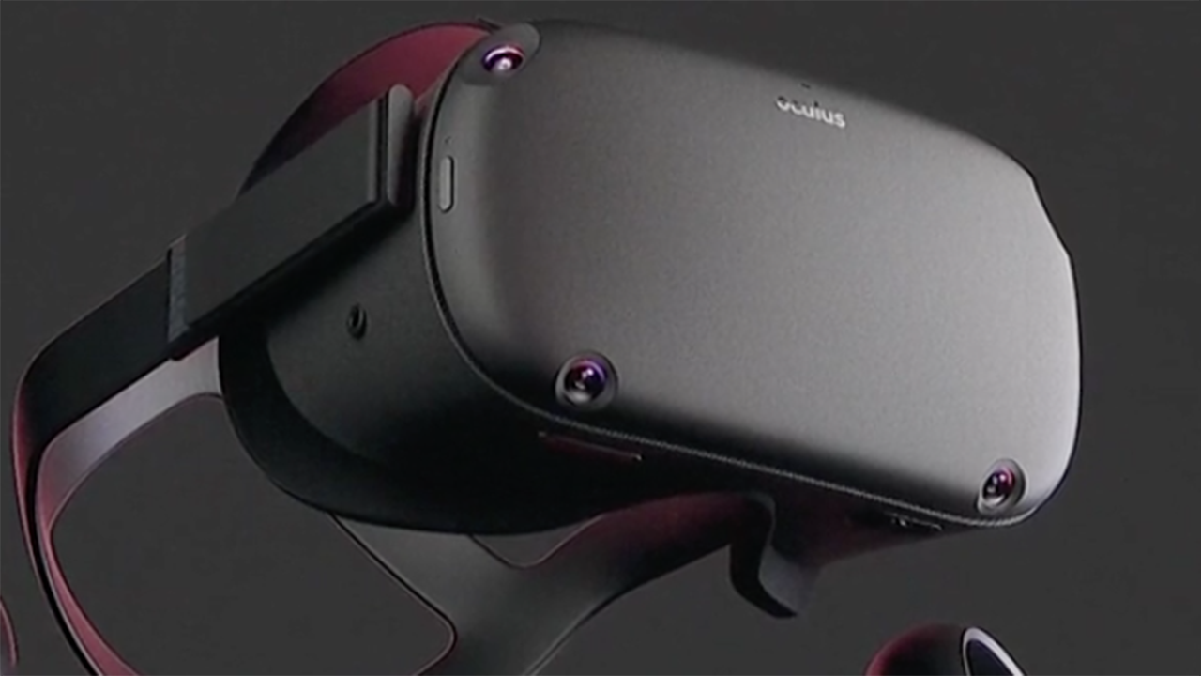
3D Vision
Depth sensors
KINECT
IR sensors

Slide 5
Singular Value Decomposition
Relation with Rank?
Lets go to the board!

Slide 6
Optimization
Short Introduction
20 December, 2018
Ajad Chhatkuli¹
1 ETH Zürich, Switzerland; NAAMII, Nepal
2 King’s/Imperial College London, UK; NAAMII, Nepal

Slide 7
What do we optimize?
We want to optimize for our model by minimizing error
Model
Input
Output
Model Parameters

Slide 8
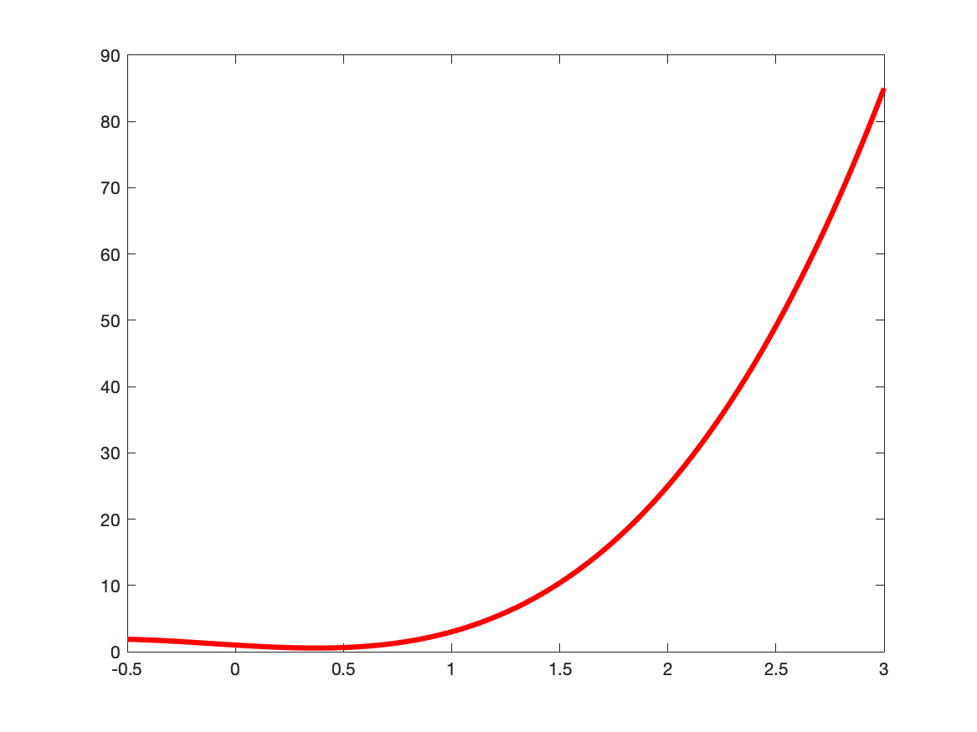
What do we optimize?
Minimize errors
Error value
Parameter value

Slide 9
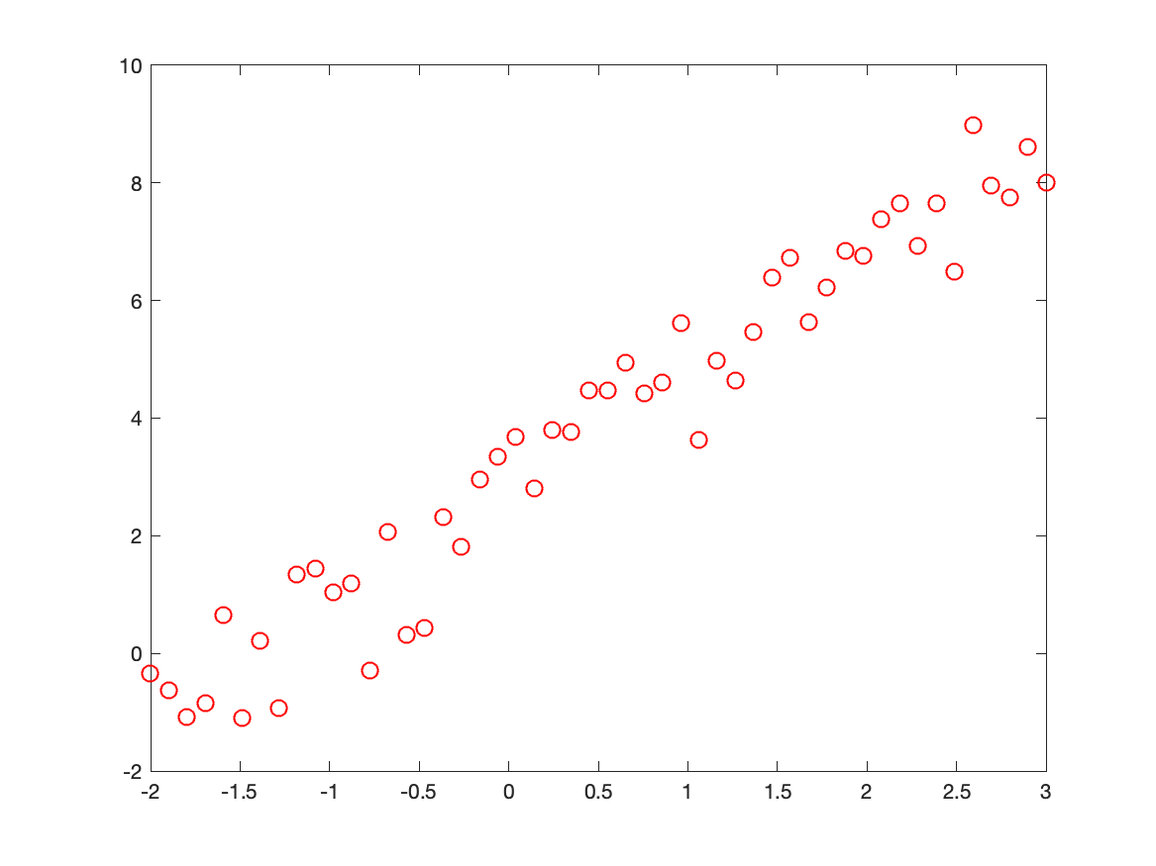
Line fitting
Noisy Data points

Slide 10
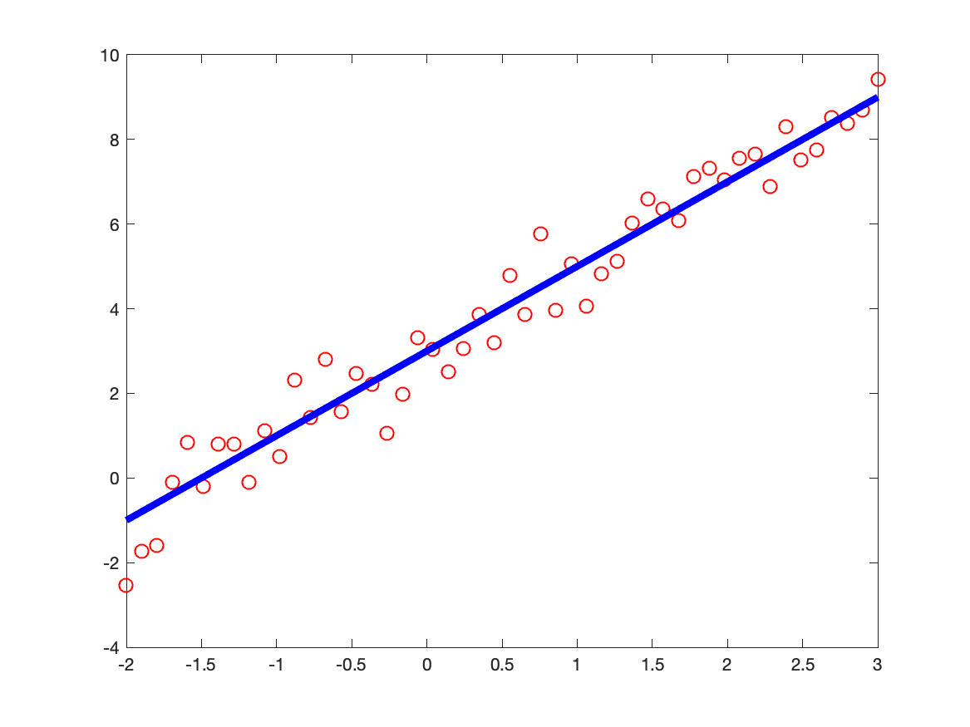
Line fitting
Fitting a line
Minimize for Model:
Sum(Model_Prediction – Data_point)

Slide 11
Line fitting
Fitting a line
Write down the equations: Input data points (x,y)
is the linear model

Slide 12
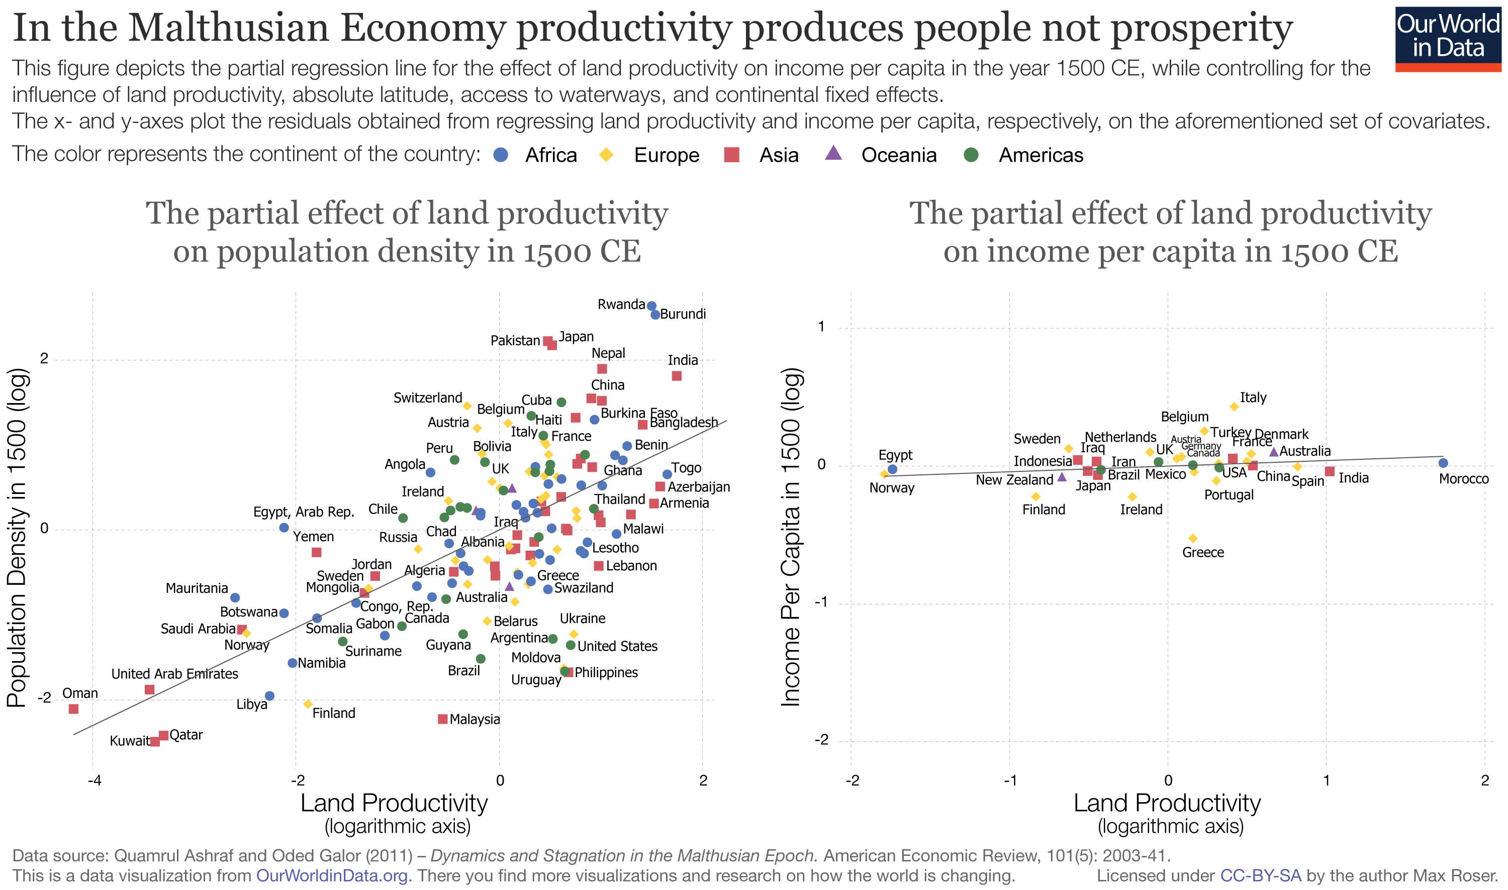
Line fitting
Source: Our World in data

Slide 13
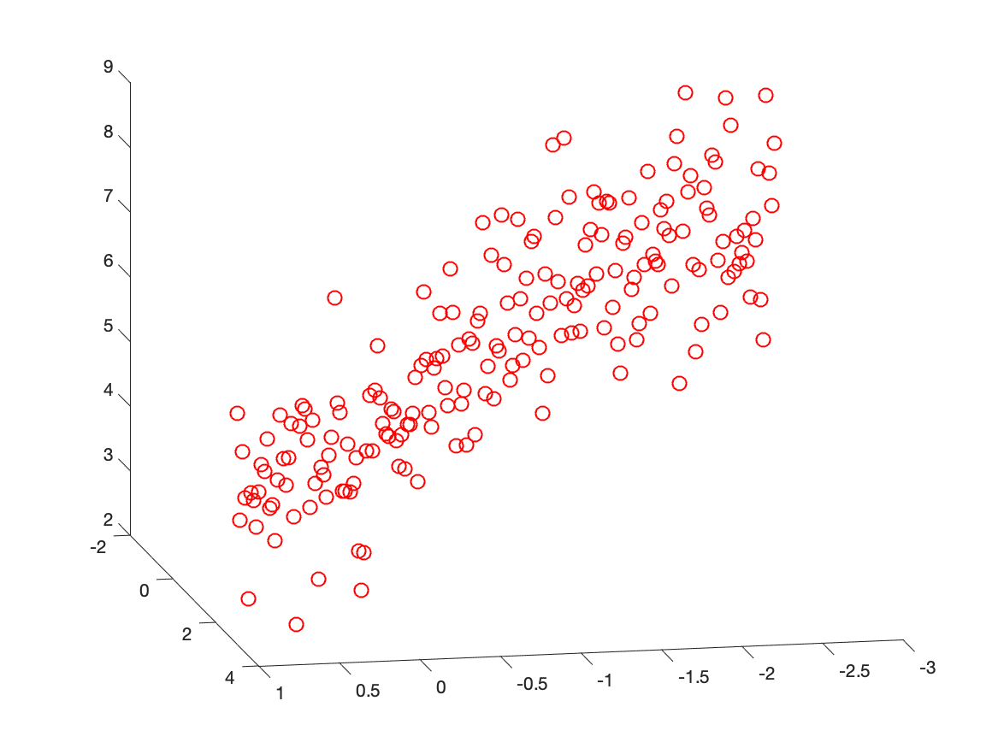
Model fitting
Least squares fitting
Plane fitting hyperplane
Sphere fitting

Slide 14
Fundamental Matrix fitting
Equation and scale
.
.
.
Scale does not matter

Slide 15
Fundamental Matrix fitting
Equation and scale
Recall SVD.
How is the scale fixed?

Slide 16
Wrong Measurements
What are the measurements?
Recall experiments
E.g., Young’s Modulus = Stress/Strain
7.0e10
7.3e10
7.1e10
6.7e10
3.0e10
6.2e10

Slide 17
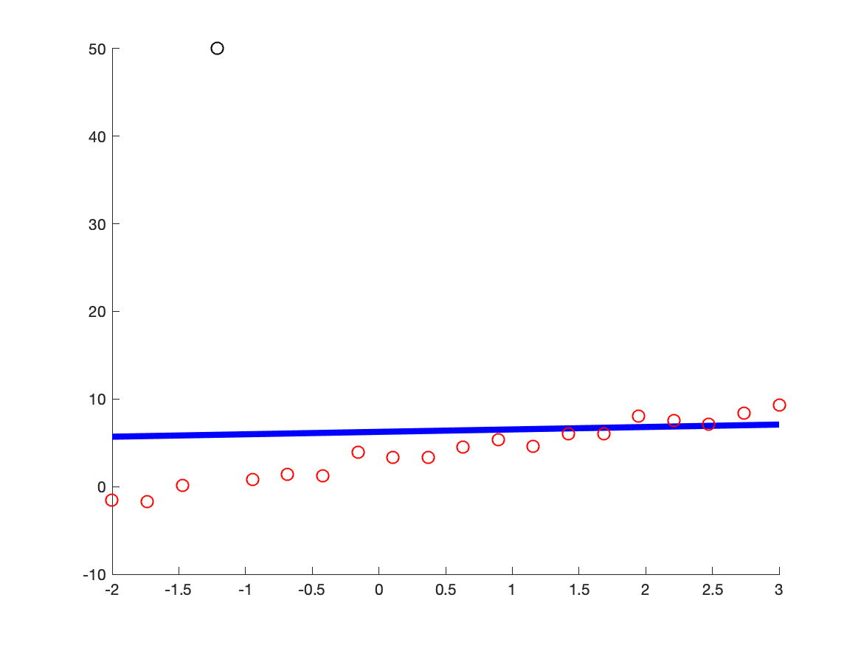
Effects of Outliers
Example: Line fitting

Slide 18
Effects of Outliers
Fundamental/Essential matrix
What could go wrong?

Slide 19
How do you solve it?
Back to line fitting
Remove the wrong
measurements

Slide 20
Solution
Line fitting
Method: Random Sampling and Consensus [Fischler et al., 1981]
Random Sampling
Consensus

Slide 21
Solution
Fitting the Fundamental Matrix
RANSAC
Take randomly ? number of points
Compute model F or E.
Compute residual
Compute how many inliers are there? Residual < 𝜀

Slide 22
Optimization problem
Expressing optimization
Optimization example

Slide 23
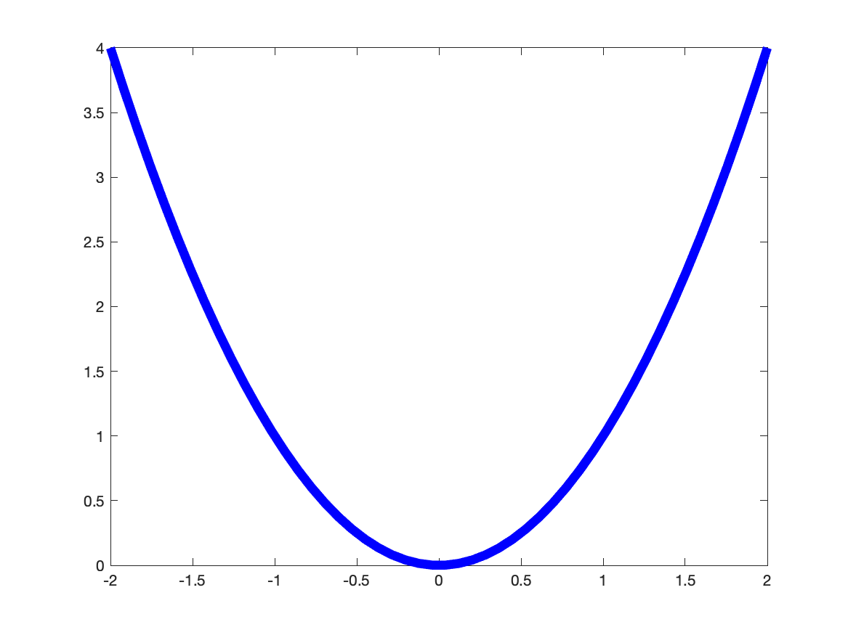
Function Derivatives
y = f(x)
What does it mean?
Increase in function
per unit change in input
x

Slide 24
Direction of Derivatives
What direction?
Single component:
Direction
Magnitude

Slide 25
Gradient Descent
Follow the direction
opposite to gradients

Slide 26
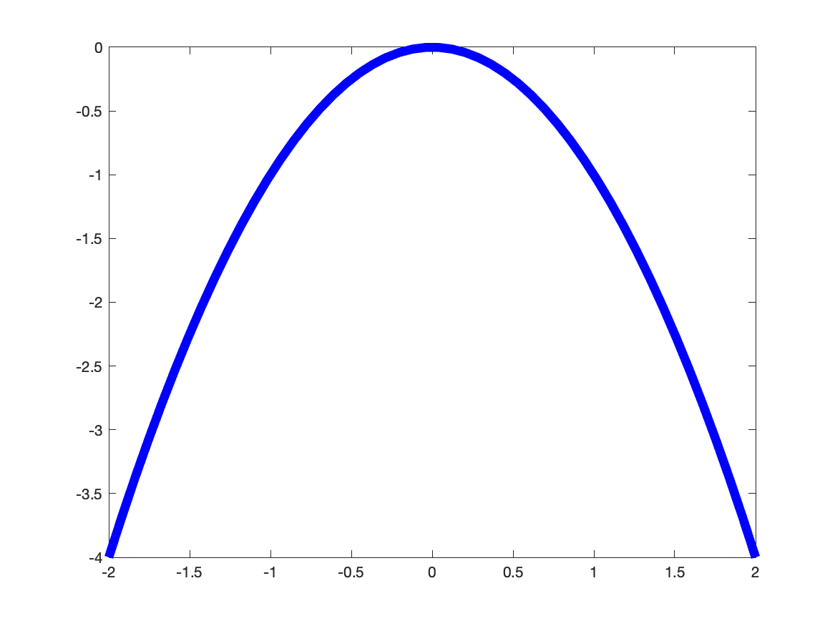
Going against the Gradient
Where does it lead to?

Slide 27
Going against the Gradient
Minimization and Maximization

Slide 28
Going against the Gradient
Minimization

Slide 29
Going against the Gradient
Minimization

Slide 30
Going against the Gradient
https://www.youtube.com/watch?v=kJgx2RcJKZY

Slide 31
Multivariate functions
Multiple input variables
Model Parameters
Model
https://www.youtube.com/watch?v=kJgx2RcJKZY

Slide 32
Derivatives for multiple variables
The Jacobian
Model Parameters
Model

Slide 33
Update equations
Gradient descent
.
.
.

Slide 34
Update equations
Gradient descent
.
.
.

Slide 35
Update equations
Gradient descent
.
.
.

Slide 36
Multiple outputs
How do you minimize a vector?
Model Parameters
Model

Slide 37
Multiple outputs
What does the vector represent? Residuals/ Differences between predictions and training labels
Model
Model Parameters

Slide 38
Multivariate functions
Minimize the square of the norm
Model Parameters
Model

Slide 39
Derivatives for Multiple outputs
Derivatives

Slide 40
Optimizing with Gradient Descent
Equations – minimize single scalar y
Equations – minimize vector norm

Slide 41
Convergence of Gradient Descent
What happens if the gradient magnitude is very high?
What happens if the gradient magnitude is very low?

Slide 42
Gauss Newton’s method
Motivation
For faster convergence assume second-order approximation of cost
Taylor’s series:
0

Slide 43
Gauss Newton’s method
Motivation
For faster convergence assume second-order approximation

Slide 44
Gauss Newton’s method
Discuss problems
Back to the board!

Slide 45
Levenberg Marquardt Method
Motivation
Combine both Gradient Descent and Gauss - Newton
Damping or regularizer

Slide 46
Levenberg Marquardt Method
More about LM
Often first method of choice
Why isn’t it used in Deep Learning?

Slide 47
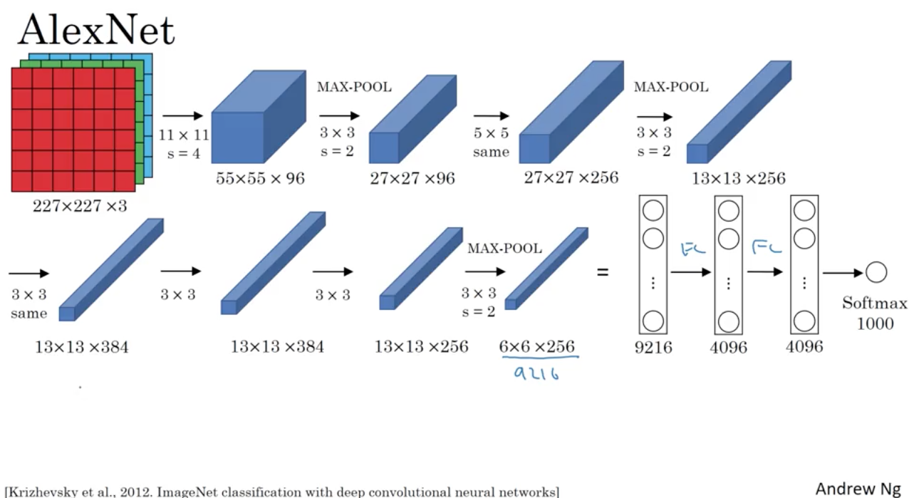
Sneak - peak into current deep learning
Size and computation of Jacobian
60M parameters

Slide 48
Stochastic Gradient Descent
Dummy example
Gradient Descent evaluates all samples for each update
Training dataset:
50 people: each person is represented by height, weight and gender
h
w
g
c
50 people: predict calories spent

Slide 49
Stochastic Gradient Descent
Dummy example
Stochastic Gradient Descent takes only one random sample
Training dataset:
50 people: each person is represented by height, weight and gender
h
w
g
c
50 people: predict calories spent

Slide 50
Objective functions
How do we design them?
Errors or residuals
They are usually vectors

Slide 51
Objective functions
How do we design them?
Examples:

Slide 52
Distance functions
Norm of differences
Used to measure distances

Slide 53
Properties of norms
L - 1 norm
L -2 norm

Slide 54
Real Examples of Optimization
Bundle Adjustment

Slide 55
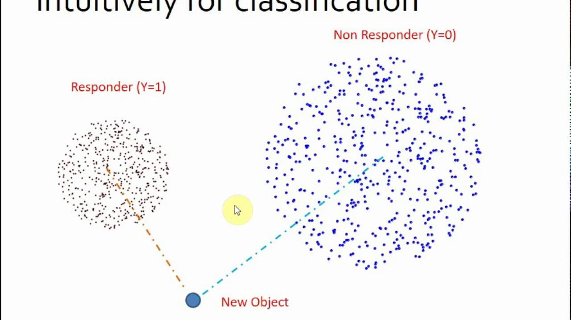
Other distance functions
The Mahalonobis distance

Slide 56
Convexity

